Slide 1
L4/5 Group 3
Game Name
Nathaniel Berger
Henry Crofts
Heather Bishop
Alex Rosca

Slide 2

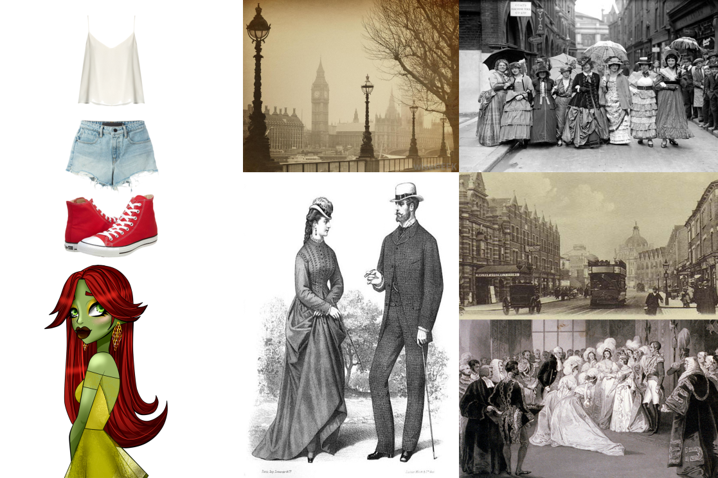
Concept Outline
Vellichor
Monachopsis

Slide 3

Game Loop Chart
Precise Jumps to land on platforms
Collect pages
(Improvement of skill = intrinsic reward)
Next level/End Level
(Progression and leader board = intrinsic reward and mastery)

Slide 4
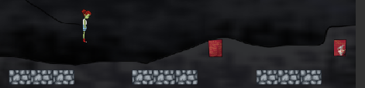
Mechanics - Jumping
A simple jump forward that is not affected by button press length.
The player character's maximum falling speed is more or less the same as their initial jumping speed

Slide 5
Mechanics - Jumping
It isn’t possible for a jumping character to change direction in mid-air.
The player must judge the time to jump accurately in order to land successfully on the next platform.

Slide 6


Concept Outline
The protagonist suffers with monachopsis, spending all of her time reading alone.
In game she is following the pages of her book as she unknowingly heads to the bookstore.

Slide 7
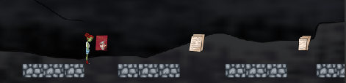
Mechanics – Twitch/Precision
To collect the pages players must jump to get from platform A to B.
Testing the players reaction time.
Platforms are generated within a certain range to prevent unreachable jumps.

Slide 8

Mechanics – Twitch/Precision
Generous zone for error using platform colliders.
Not too generous as jumping off point must be judged precisely.

Slide 9
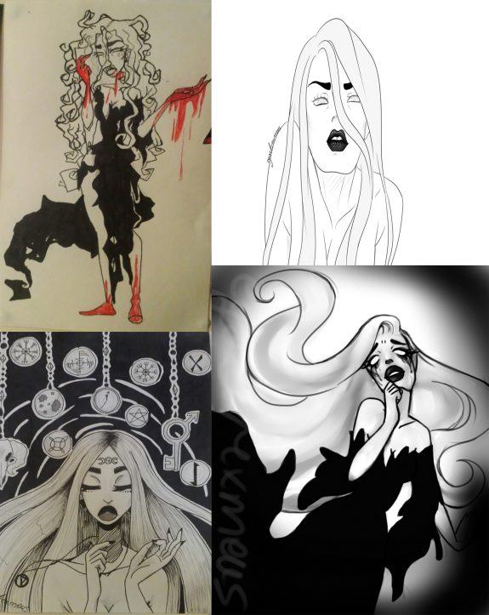
Concept Outline
Once the player has collected all the pages she arrives at the bookstore.
The bookstore owner gifts the player the book, resolving the protagonists monochopsis and introducing the vellichor

Slide 10
Aesthetics
Serious fun and hard fun.
Physical challenge to press the jump button at the right time to land on the platform.
Mental challenge to accurately jump between platforms.
Monachopsis is promoted by the stark saturation contrast between protagonist and scenery.
Vellichor is promoted by the scene in the bookshop on the start screen.

Slide 11
Play Testing Results

Slide 12
Playtesting Results
Not enough variation in game play.
Conflicting reports on if the challenge was too much/too little.
Players did have some fun whilst playing, as their time perception was distorted.

Slide 13
Sprint Information
Hours Logged
Nathaniel:42
Henry:56
Alex: 38
Heather: 56
Emails Sent
Nathaniel: 30
Henry: 65
Alex: 33
Heather: 73

Slide 14
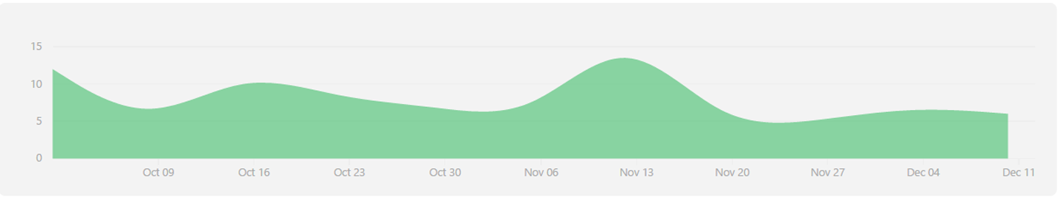
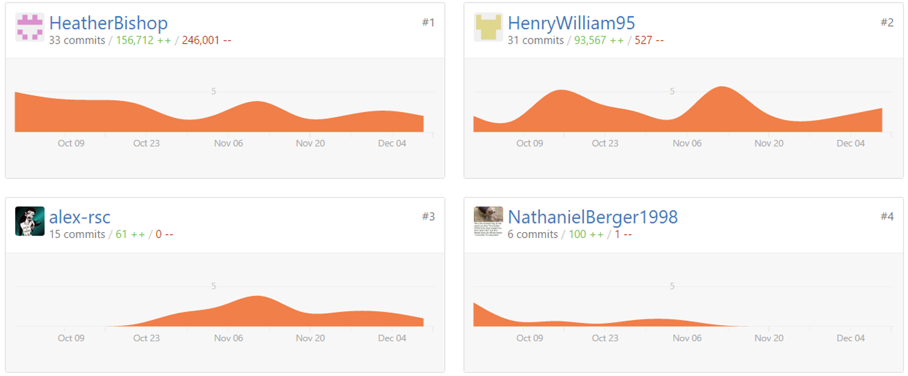
Performance Charts
Overall Performance

Slide 15
Lessons Learnt From This Project
To spend more time brainstorming ideas and mechanics.
Rapidly create a paper prototype focusing on bare bones mechanics and fun.

Slide 16
Questions?

